Slide 1
Digital product design
Lecture 5: Pricing
Alex Moehring

Slide 2
Outline
Pricing Strategies
Pricing Analytics
Pricing Digital Goods

Slide 3
Common pricing strategies

Slide 4
Pricing Strategies
Cost-based pricing – Bad
Competition-based pricing – Bad
Customer-based pricing – Bad
Value based pricing – Good

Slide 5
Cost Based Pricing
Charge a markup over average cost
Problems
Hard to project costs
Costs depend on sales, which depend on prices
Backwards looking
When sales go down, average costs increase. Good time to raise prices?

Slide 6
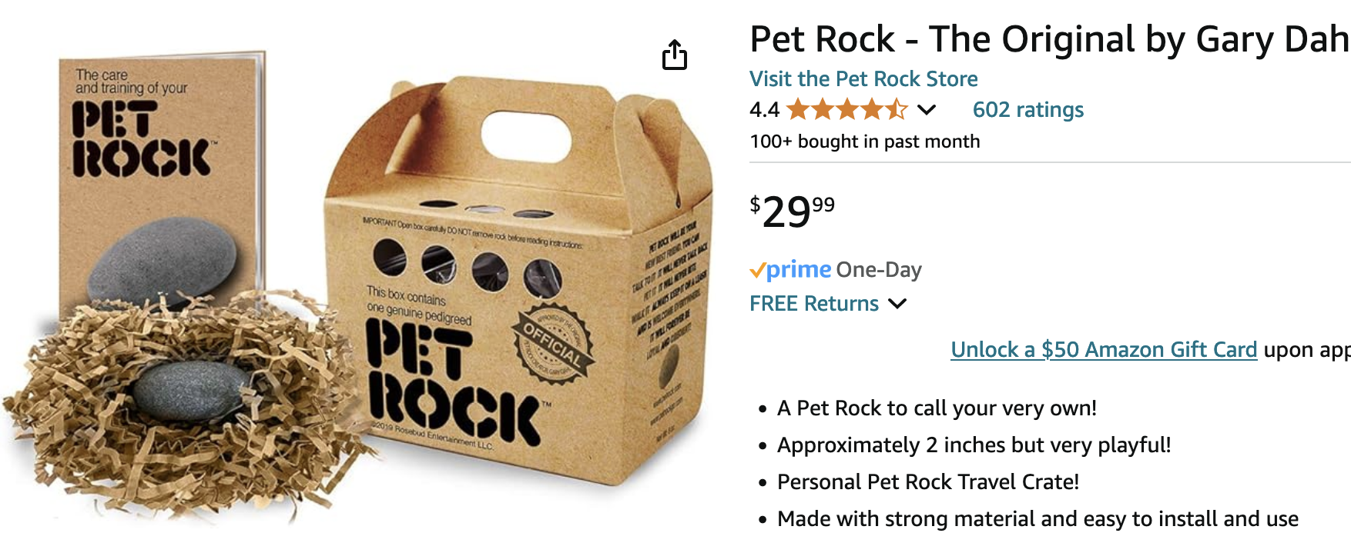
Cost Based Pricing – Ignores Value Created
Notes:
Pet Rocks were a 1970s fad conceived by Los Gatos, California advertising executive Gary Dahl. Pebbles, imported from Rosarito Beach in Baja California, Mexico, were swaddled in excelsior, nestled in a small cardboard box similar to a pet carrier, and included a ‘Pet Rock Training Manual.’ The cost was pennies. The fad peaked in the Christmas season in December 1975, but in its short run, the Pet Rock made Dahl a millionaire, by selling Pet Rocks at $3.95 each. Cost- based pricing would have missed the value created.

Slide 7
Competition Based Pricing
Design product, find competitors price, set price at or below competitor
Problems
Ignores unique value proposition
Ideally, our product creates more value for our customers!
Ignores competitor response
If we undercut competitors, will they change their price?

Slide 8
Customer Based Pricing
Ask customers their valuation and set price based off average
Problems
Customers lie
Radiohead “pay what you want” album, 62% paid $0
Average valuation is uninformative
We care most about customers willing to pay high prices!

Slide 9
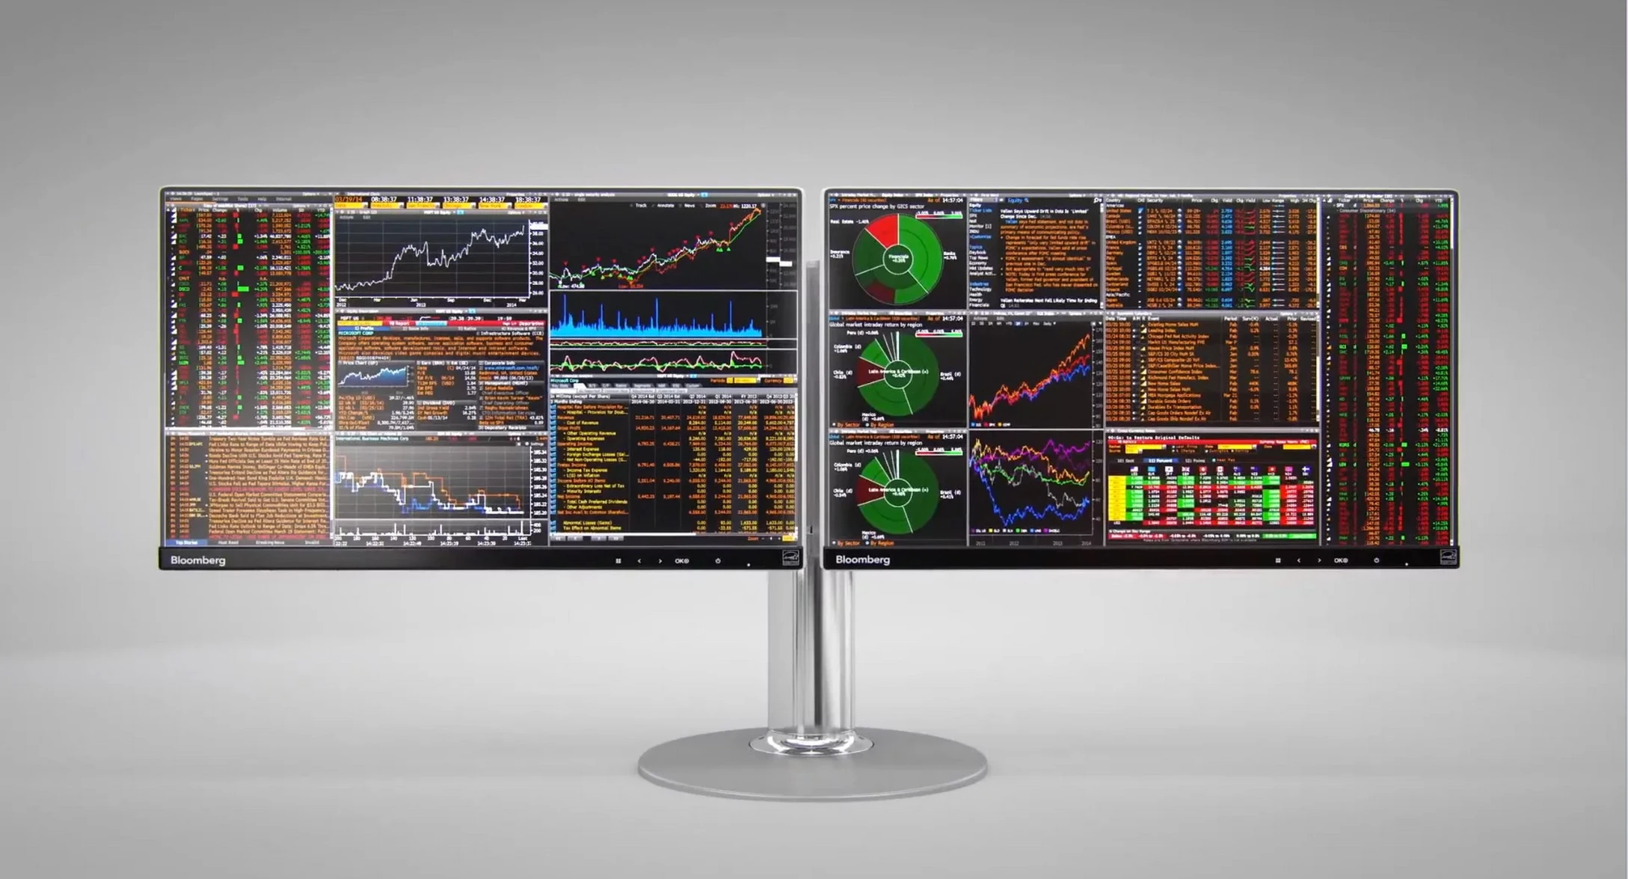
Average Values can be Misleading
Source: Bloomberg

Slide 10
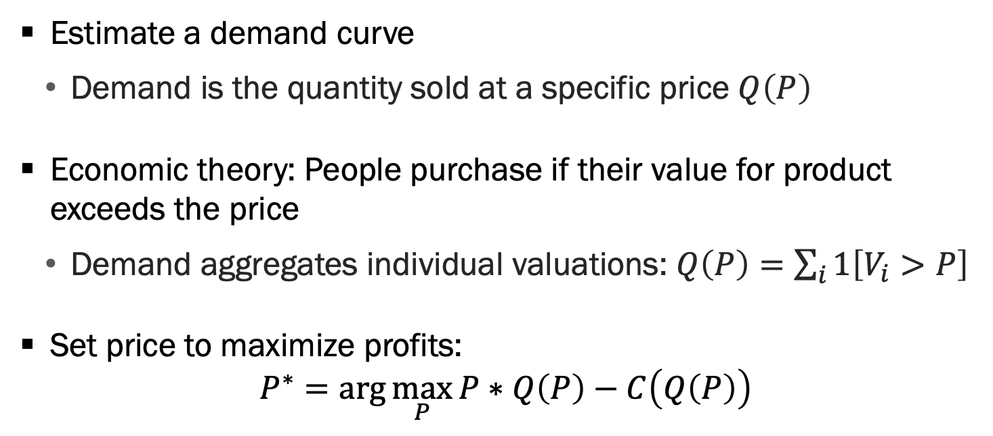
Value Based Pricing
Estimate a demand curve
Demand is the quantity sold at a specific price $Q\left(P\right)$
Economic theory: People purchase if their value for product exceeds the price
Demand aggregates individual valuations: $Q\left(P\right)=\sum_{i}{1\left[V_{i}>P\right]}$
Set price to maximize profits:
$$P^{∗}=\arg{\max_{P}{P∗Q\left(P\right)−C\left(Q\left(P\right)\right)}}$$

Slide 11
Pricing with a Demand Curve
P
D
Consumer surplus
P>MC
DWL
Producer surplus
MC
Q
Notes:
Economic graph showing price (P) versus quantity (Q) with a downward-sloping demand curve (D) and a horizontal marginal cost (MC) line. The area above MC and below demand is divided into consumer surplus (brown), producer surplus (black), and deadweight loss (DWL), illustrating inefficiency when price exceeds marginal cost.

Slide 12
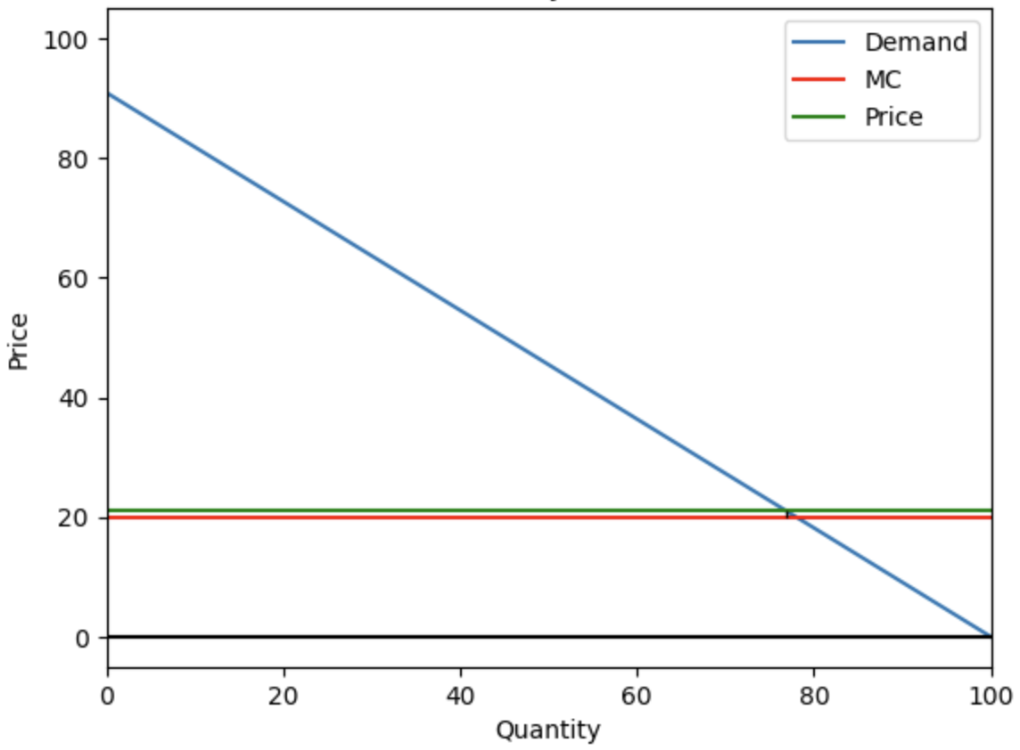
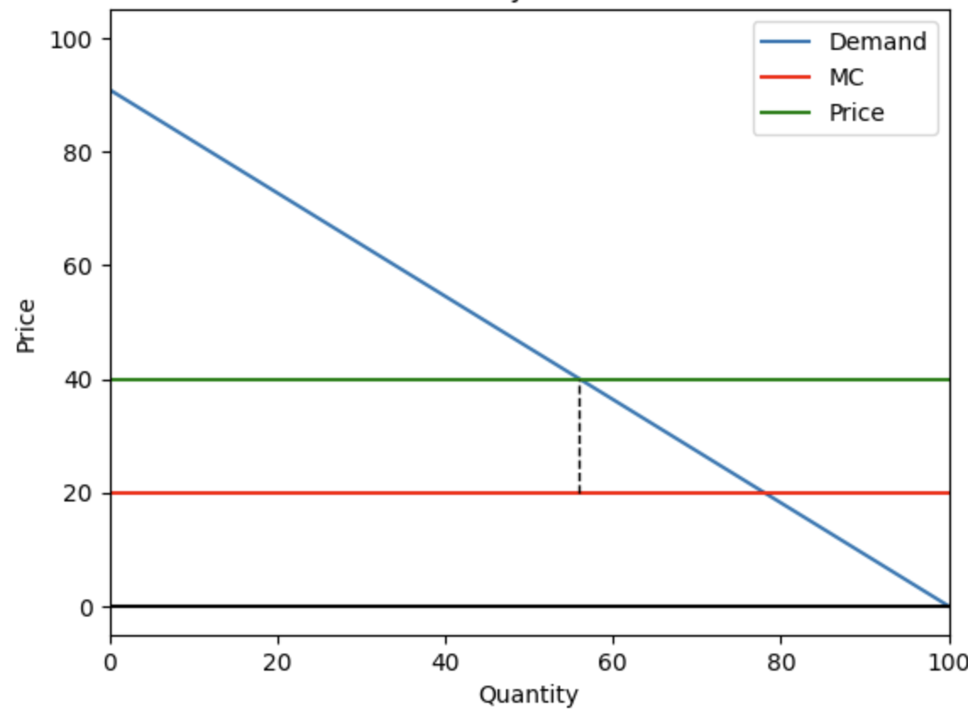
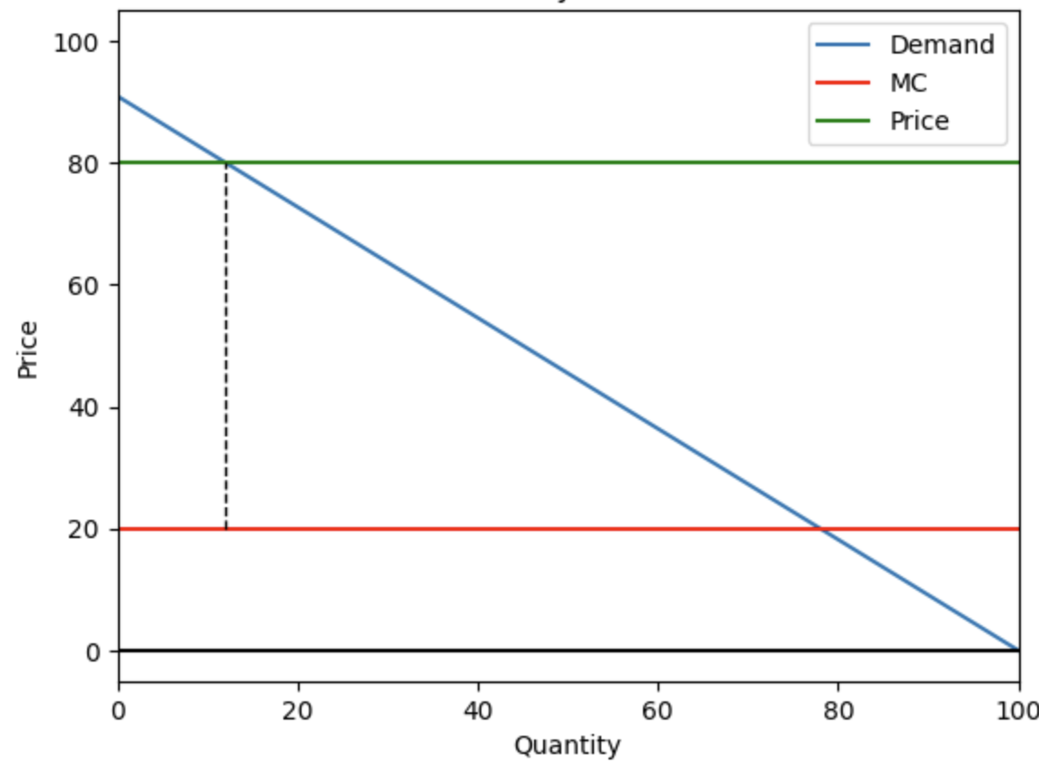
Examples: How Price Impacts Profits

Slide 13
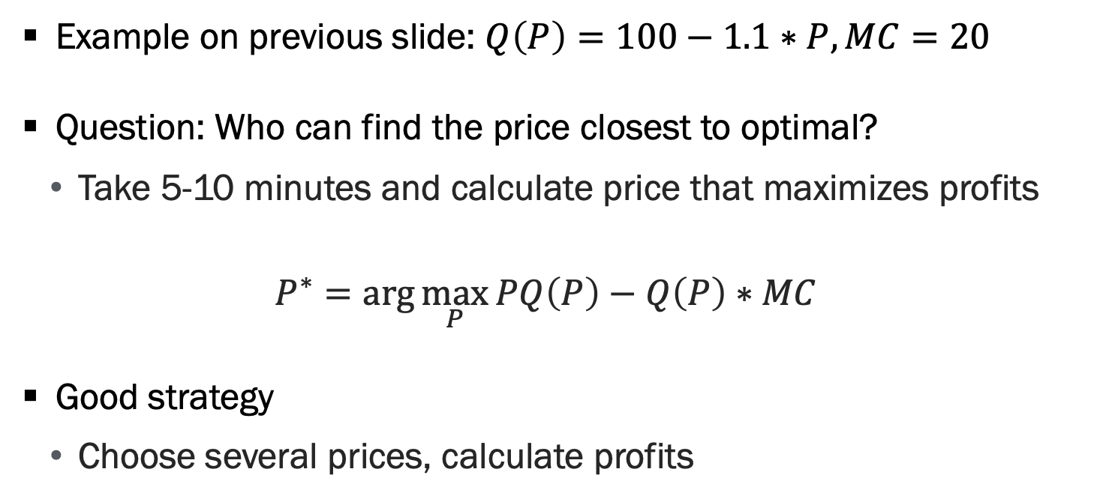
Quick Exercise
Example on previous slide: $Q\left(P\right)=100−1.1∗P, MC=20$
Question: Who can find the price closest to optimal?
Take 5-10 minutes and calculate price that maximizes profits
$$P^{∗}=\arg{\max_{P}{PQ\left(P\right)−Q\left(P\right)∗MC}}$$
Good strategy
Choose several prices, calculate profits

Slide 14
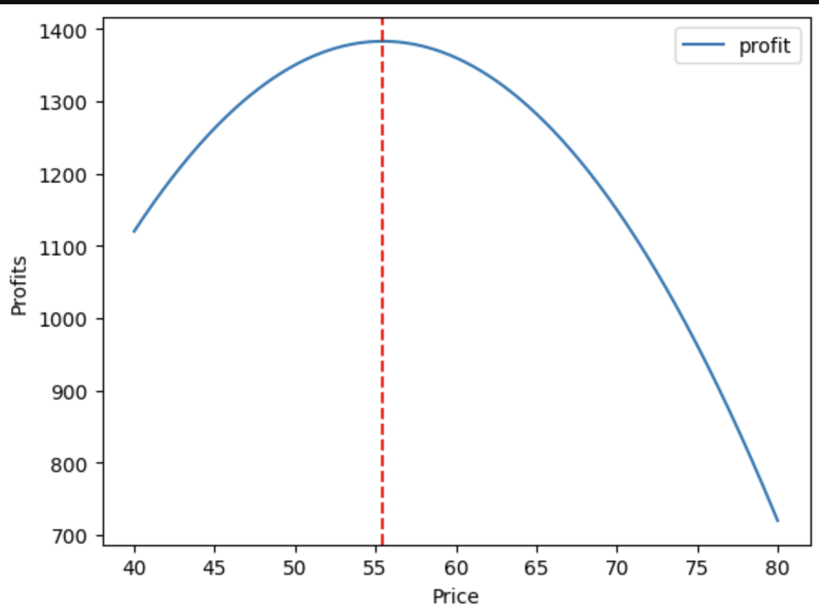
Quick Exercise, Continued

Slide 15
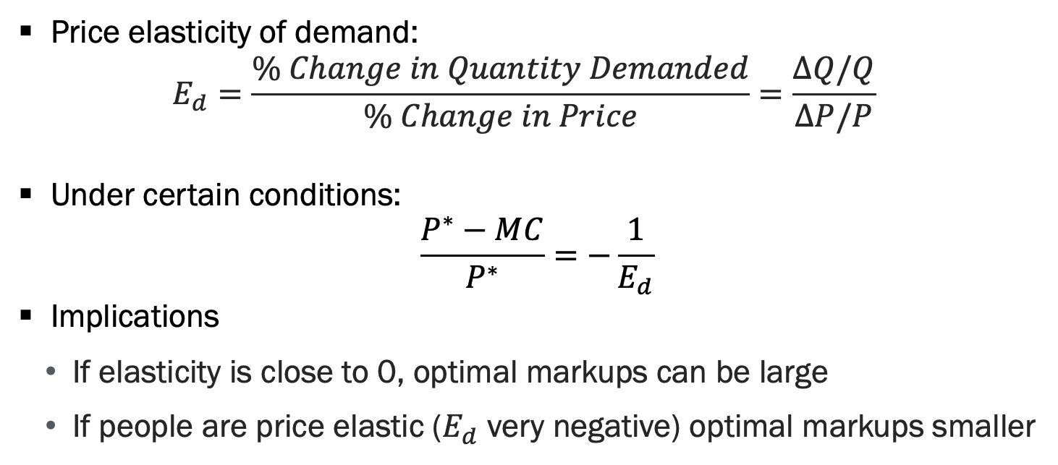
Price Elasticity is a Key Quantity
Price elasticity of demand:
$$E_{d}=\frac{\% Change in Quantity Demanded}{\% Change in Price}=\frac{ΔQ/Q}{ΔP/P}$$
Under certain conditions:
$$\frac{P^{∗}−MC}{P^{∗}}=−\frac{1}{E_{d}}$$
Implications
If elasticity is close to 0, optimal markups can be large
If people are price elastic ($E_{d}$ very negative) optimal markups smaller

Slide 16
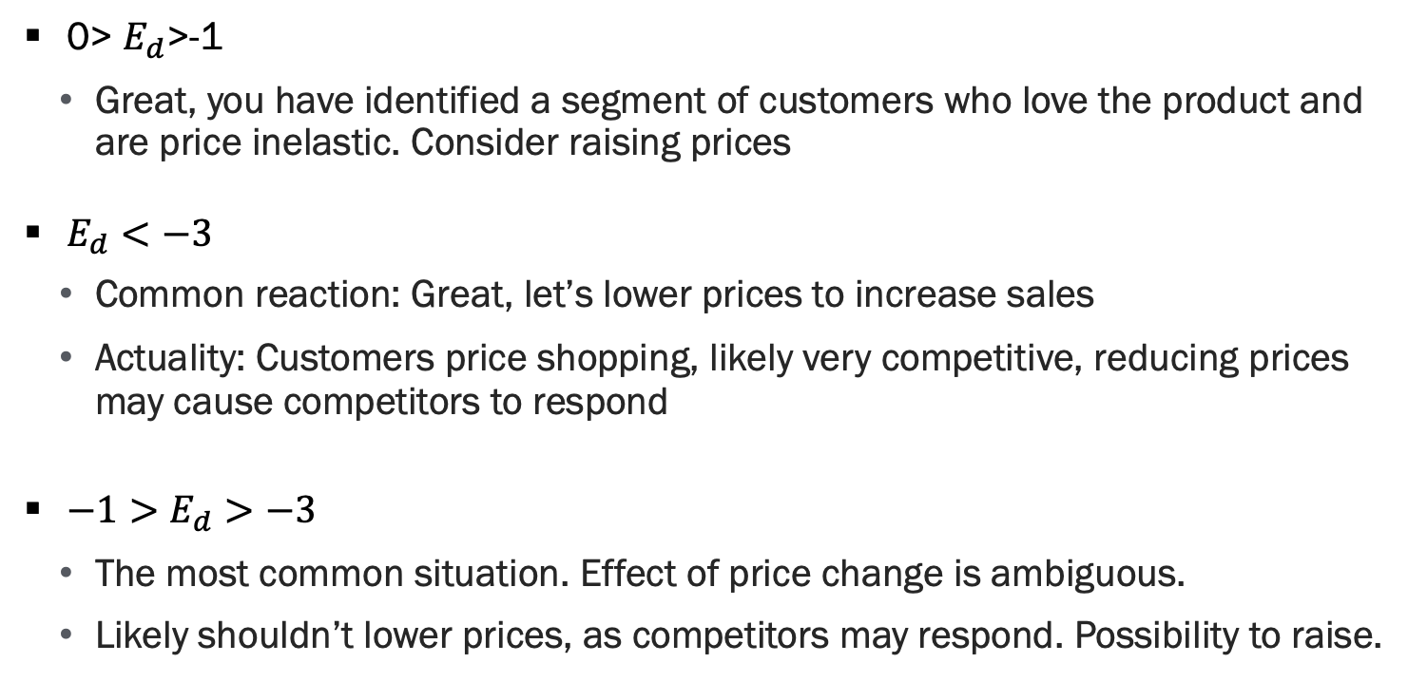
Interpreting Elasticities
0> $E_{d}$>-1
Great, you have identified a segment of customers who love the product and are price inelastic. Consider raising prices
$E_{d}<−3$
Common reaction: Great, let’s lower prices to increase sales
Actuality: Customers price shopping, likely very competitive, reducing prices may cause competitors to respond
$−1>E_{d}>−3$
The most common situation. Effect of price change is ambiguous.
Likely shouldn’t lower prices, as competitors may respond. Possibility to raise.

Slide 17
Pricing in practice

Slide 18
Pricing in Practice, Continued
Given demand curve and costs, we can calculate optimal price
What do we need to do this?
Demand and costs!
Important that these estimates are causal, need “good” variation in prices

Slide 19
Estimating Demand in Historical Data
Key questions:
Has your firm changed prices?
Are these price changes un-correlated with other changes (i.e. demand)?
Have you run any pricing experiments?
If yes, ask your data scientists to estimate demand curve for you!

Slide 20
Estimating Demand in New Data
Are we able to run pricing experiments?
If so, create good variation in prices and estimate demand curve
Can be risky if consumers see others paying different prices
Survey experiments next best thing
Ask potential customers if they would purchase in a hypothetical environment for a price that is randomly assigned
Important to make this as realistic as possible
Each person makes a single choice (purchase or not)

Slide 21
Segmenting Customers
We can also try to predict our high-value customers
Customers who value product a bunch
Also known as price-inelastic customers
If we raise prices, they still purchase
If we can identify these customers, potential to charge them a different price
Known as personalized pricing or “price discrimination”
Common methods: Student discount, changing prices over time

Slide 22
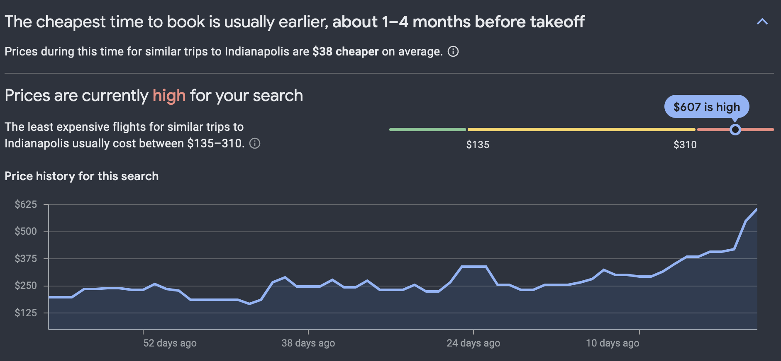
Why do Airline Prices Rise Over Time?
Source: Google Flights

Slide 23
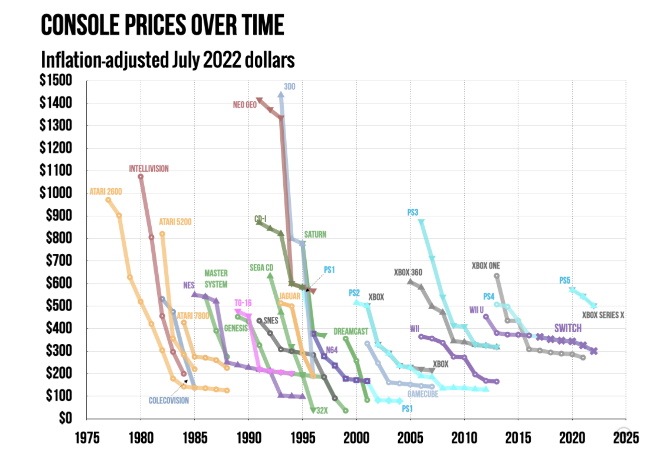
Price Skimming
Source: Ken Wilbur

Slide 24

Versioning
Source: Ken Wilbur
Notes:
Exists offline too, hardcover then softcover books. First class vs economy. Easier online

Slide 25
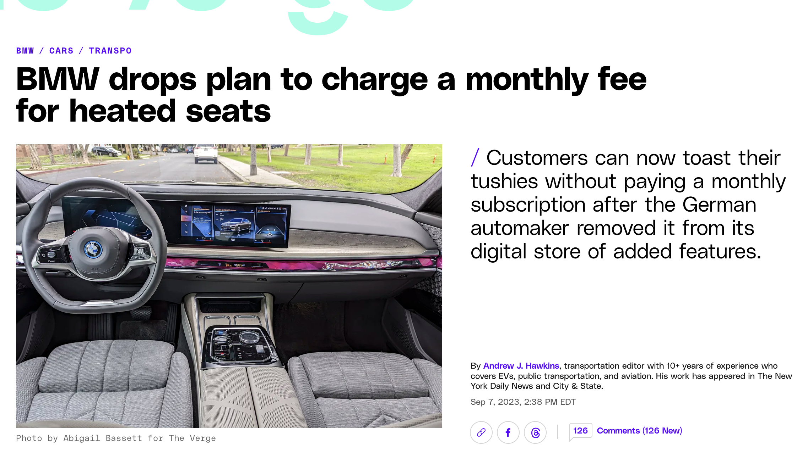
Versioning, Part 2
Source: Ken Wilbur
Notes:
Exists offline too, hardcover then softcover books. First class vs economy. Easier online

Slide 26
Versioning, Part 3
Exists in both online and offline worlds
E.g. hardcover vs softcover books, first-class vs economy
Typically have 3 versions for software
Take advantage of the compromise effect (next section)
If low-end version has P=0, this can be a barrier to converting people to paying customers
Source: Ken Wilbur
Notes:
Exists offline too, hardcover then softcover books. First class vs economy. Easier online

Slide 27
Behavioral Pricing

Slide 28
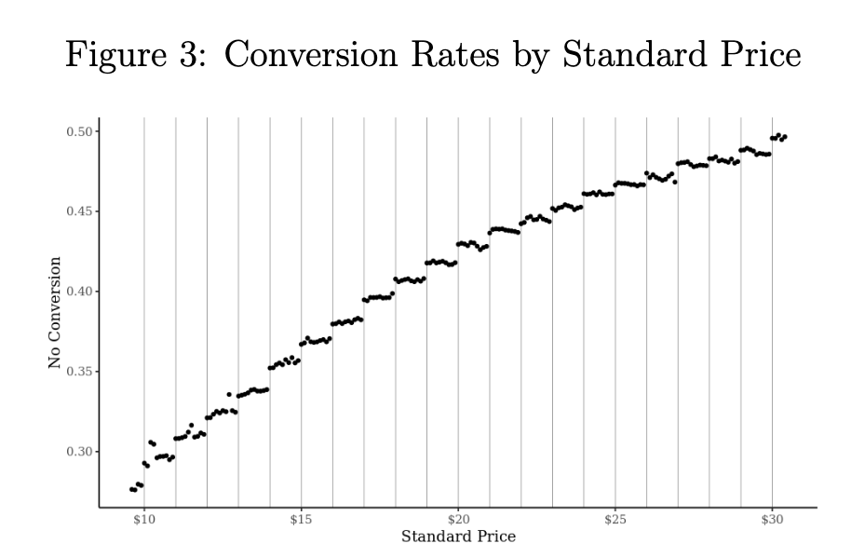
Demand Curves at Lyft – Left Digit Bias
Source: List et al (2023)

Slide 29
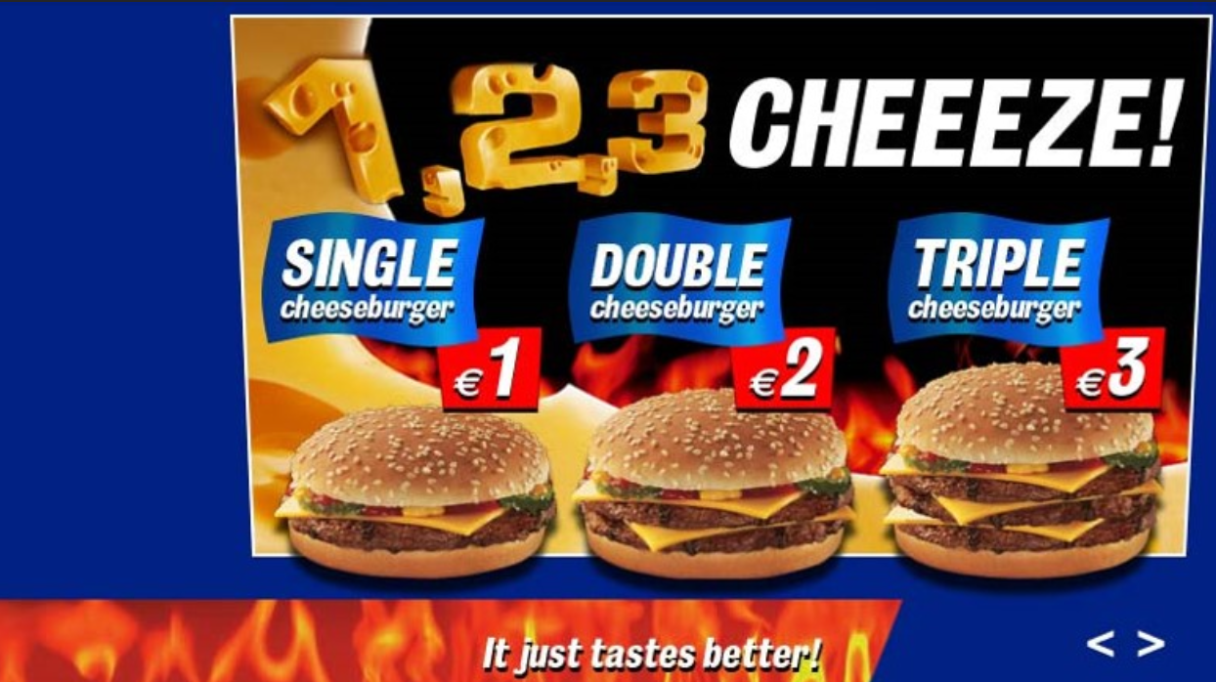
Compromise Effect
Source: Tucker (2023)
Notes:
Sales go from 50/50 to 30/60/10

Slide 30
Compromise Effect, Continued
Source: Tucker (2023)
Notes:
Sales go from 50/50 to 30/60/10

Slide 31
Pricing digital goods

Slide 32
Digital Goods are Unique
Zero marginal cost
Marginal cost of replicating bits is ~0
Non-rival
Me watching a movie on Netflix does not preclude you from watching

Slide 33
Implications for Pricing – Bundling
Bundling is rampant in digital markets, particularly in content
E.g. Netflix, YouTube premium, versioning
Bundling example: Three types of consumers
Sports lovers (40%): WTP $50 for ESPN only
Comedy lovers (40%): WTP $50 for Comedy Central (CC) only
Diverse preference (20%): WTP $30 for ESPN and $30 for CC

Slide 34
Implications for Pricing – Bundling, Part 2
Question 1: What is best price to choose if we price ESPN & CC separately?

Slide 35
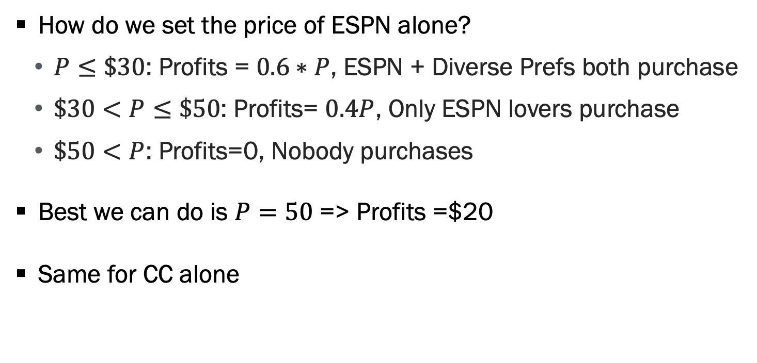
Example – No Bundling
How do we set the price of ESPN alone?
$P≤\$30$: Profits = $0.6∗P$, ESPN + Diverse Prefs both purchase
$\$30<P≤\$50$: Profits= $0.4P$, Only ESPN lovers purchase
$\$50<P$: Profits=0, Nobody purchases
Best we can do is $P=50$ => Profits =$20
Same for CC alone

Slide 36
Implications for Pricing – Bundling, Part 3
Question 2: What is best price to choose if we price ESPN & CC as a bundle?
Meaning we offer 1 price for access to both channels
Hint: Diverse preference types value bundle at $60

Slide 37
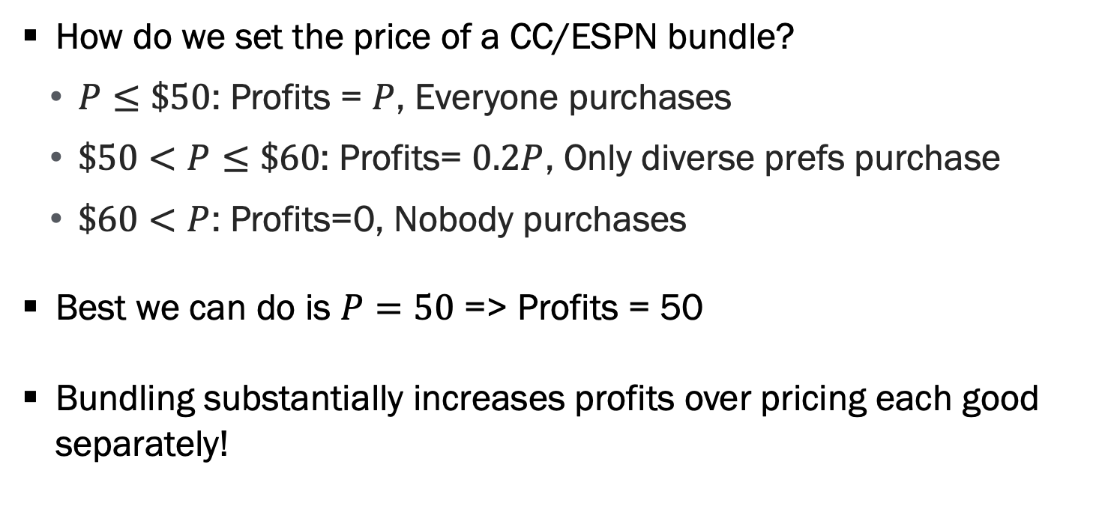
Example – Bundling
How do we set the price of a CC/ESPN bundle?
$P≤\$50$: Profits = $P$, Everyone purchases
$\$50<P≤\$60$: Profits= $0.2P$, Only diverse prefs purchase
$\$60<P$: Profits=0, Nobody purchases
Best we can do is $P=50$ => Profits = 50
Bundling substantially increases profits over pricing each good separately!

Slide 38
Question: Why Bundling So Effective in Digital Goods?

Slide 39
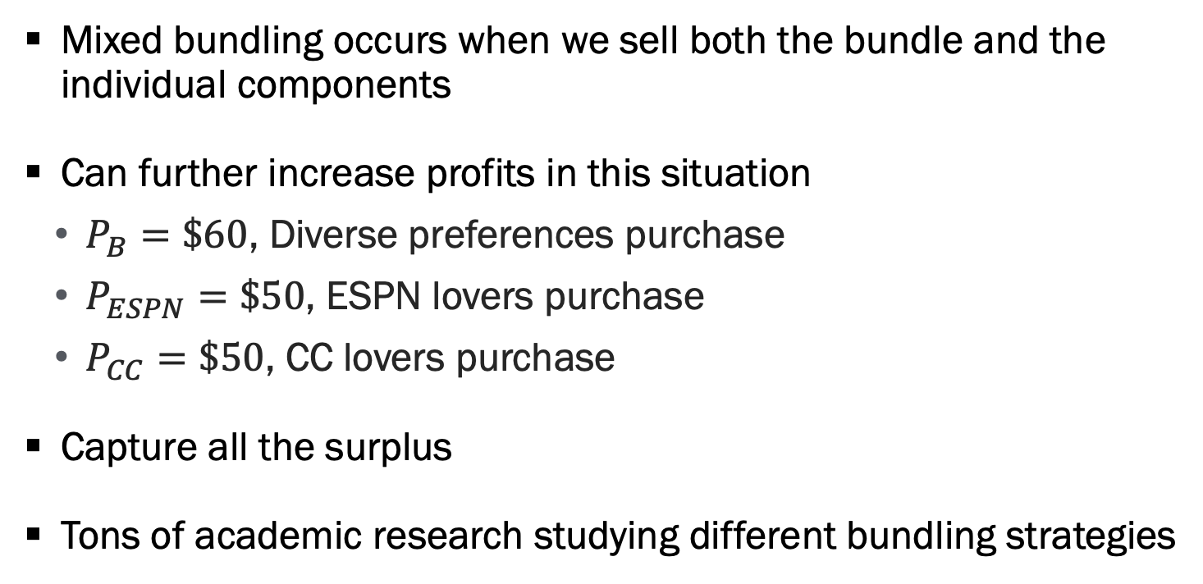
Example – Mixed Bundling
Mixed bundling occurs when we sell both the bundle and the individual components
Can further increase profits in this situation
$P_{B}=\$60$, Diverse preferences purchase
$P_{ESPN}=\$50$, ESPN lovers purchase
$P_{CC}=\$50$, CC lovers purchase
Capture all the surplus
Tons of academic research studying different bundling strategies

Slide 40
Increased Price Transparency?
Many thought that internet would remove cost of comparing prices
Idea is this would increase competition, lowering prices and prices dispersion
Didn’t necessarily pan out as predicted
Price dispersion remains online
As search technology improves, so does ability to obfuscate prices
Add-on pricing, additional fees, etc

Slide 41
Last Comment on Pricing
Of all the topics covered, this is the most likely to put you in jail
Price fixing & bid rigging (auctions) is illegal
This includes tacit collusion
Many examples of extremely wealthy people (with good lawyers) sentenced to jail time for such actions
Algorithmic pricing does not absolve you from risk

Slide 42
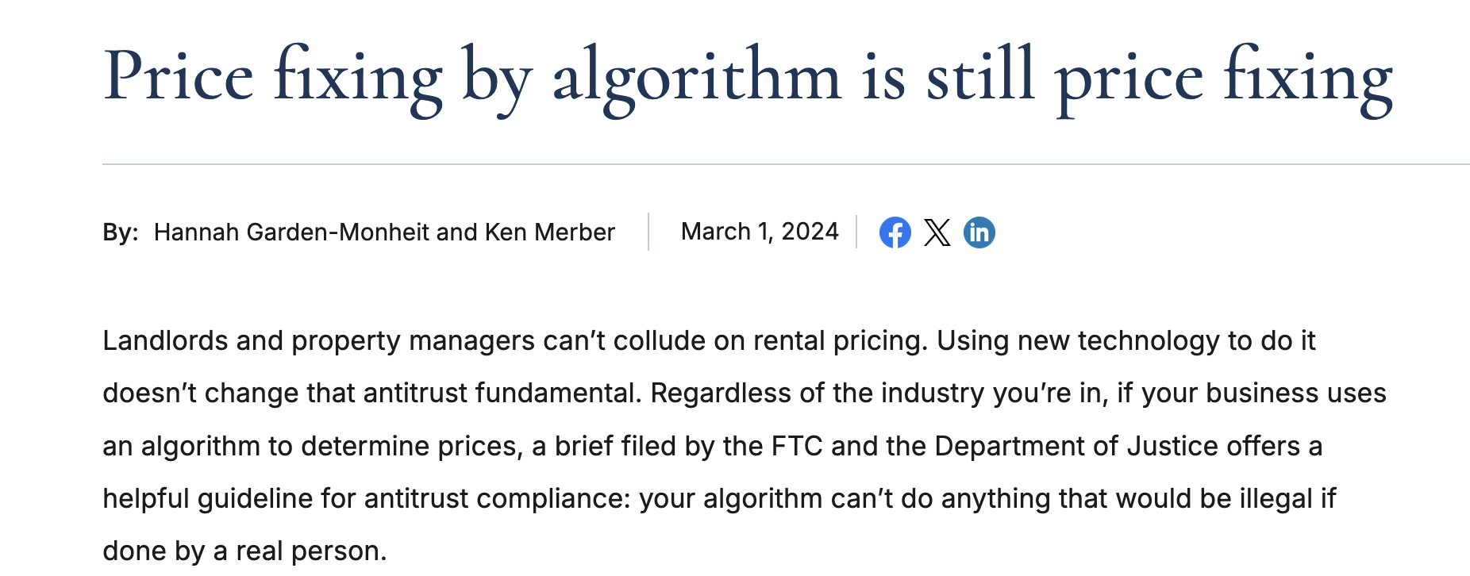
Last Comment on Pricing, Continued

Slide 43
Questions

